Slide 1
2048 Game
Somesh Rao Coka ST122892​

Slide 2
“Make it look as dirty as possible, use your skills to code” - Professor

Slide 3
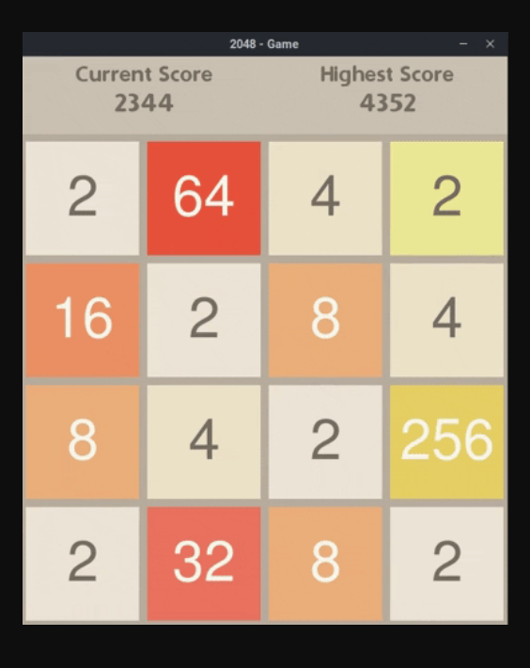
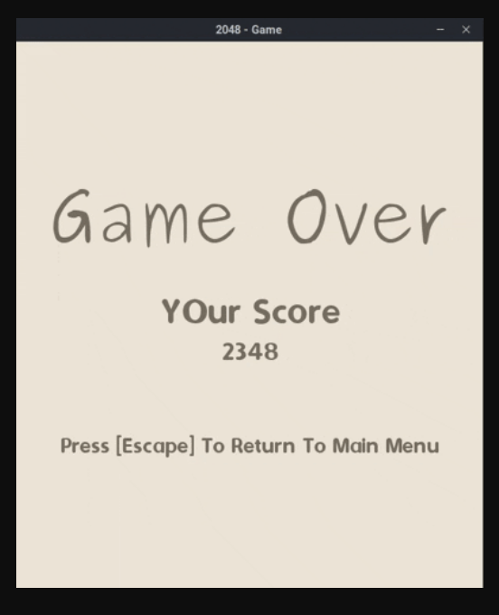
Project Expectations

Slide 4
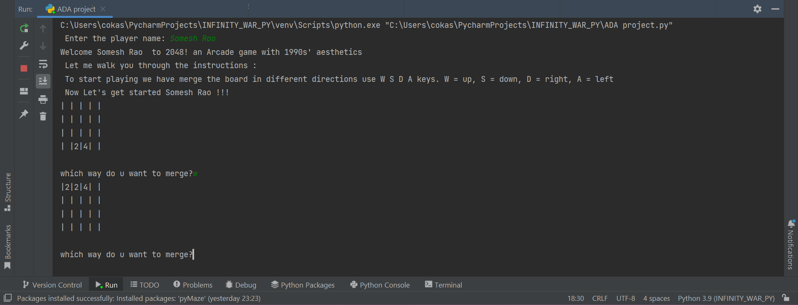
Reality check

Slide 5


Agenda
A
Introduction
My Approach
My Work
Data-Structure used
Future work
Limitations

Slide 6
Introduction
2048 is a popular game
we add 2 numbers starting from number 2
And it grows in powers of 2
A Winner is declared upon reaching number 2048
And rest all cases Better Luck Next Time!

Slide 7
Approach

Slide 8
Steps
Setting up a broad using lists.
Creating different functions to merge left, right, up, & down.
Start game with 2 numbers at random place.
Set up rounds of the game.
Set up adding new values each time
Set up whether user won the game or not

Slide 9
My Work

Slide 10
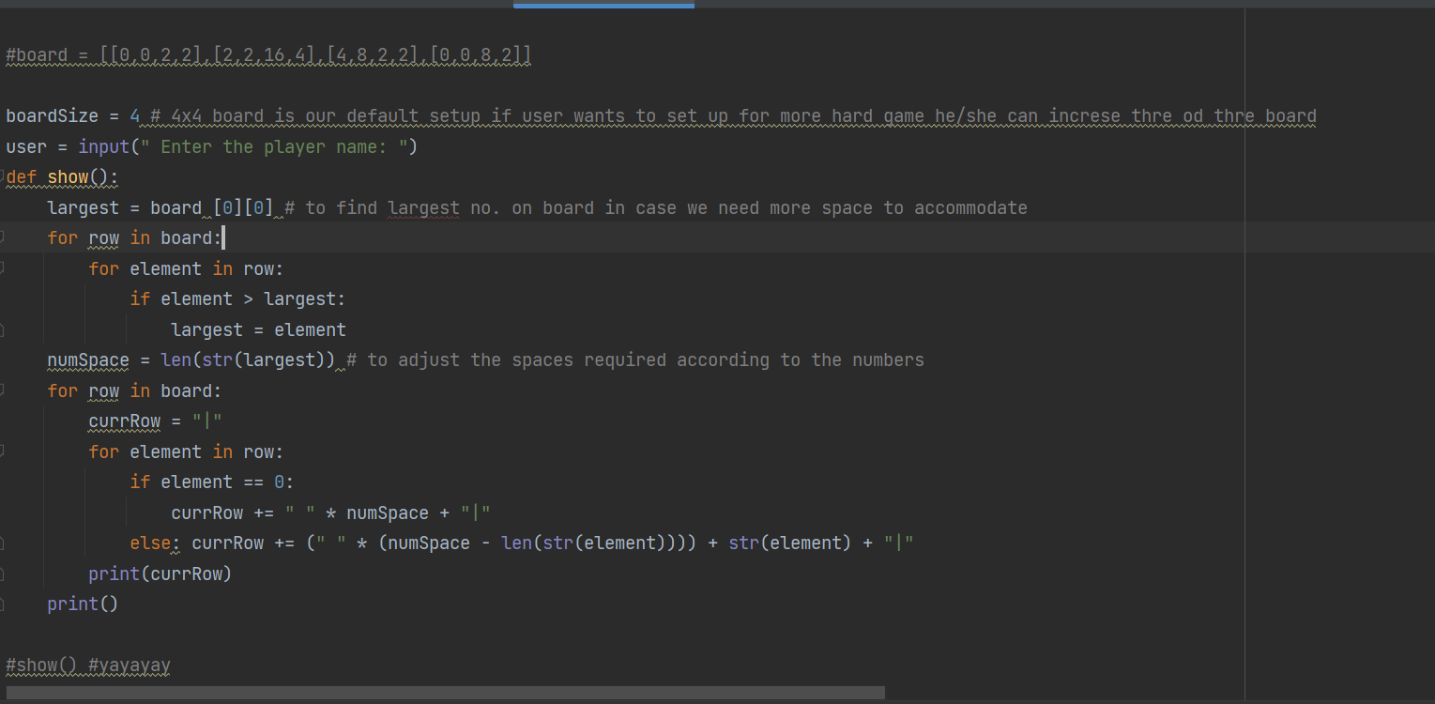
Code snippets (view)

Slide 11
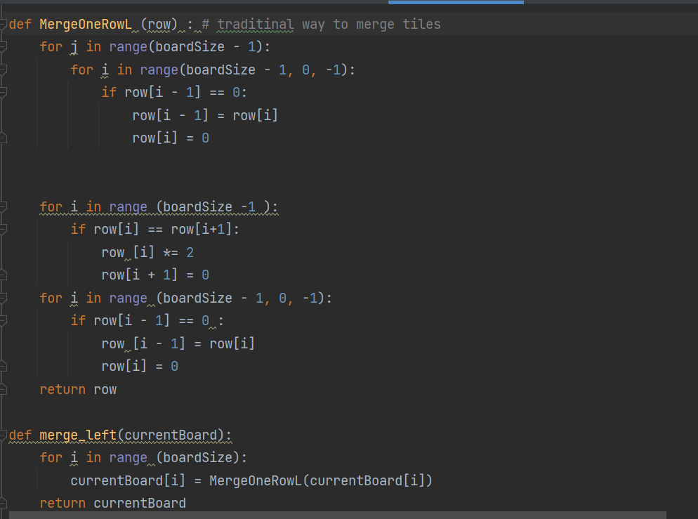

Slide 12
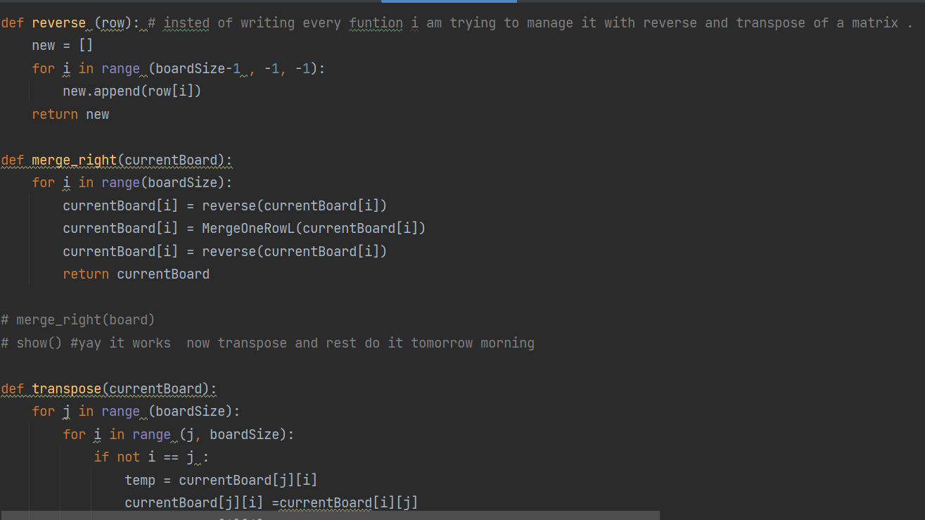

Slide 13
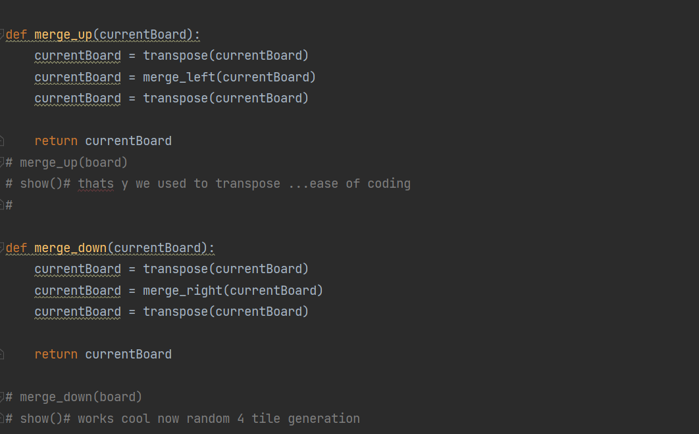

Slide 14
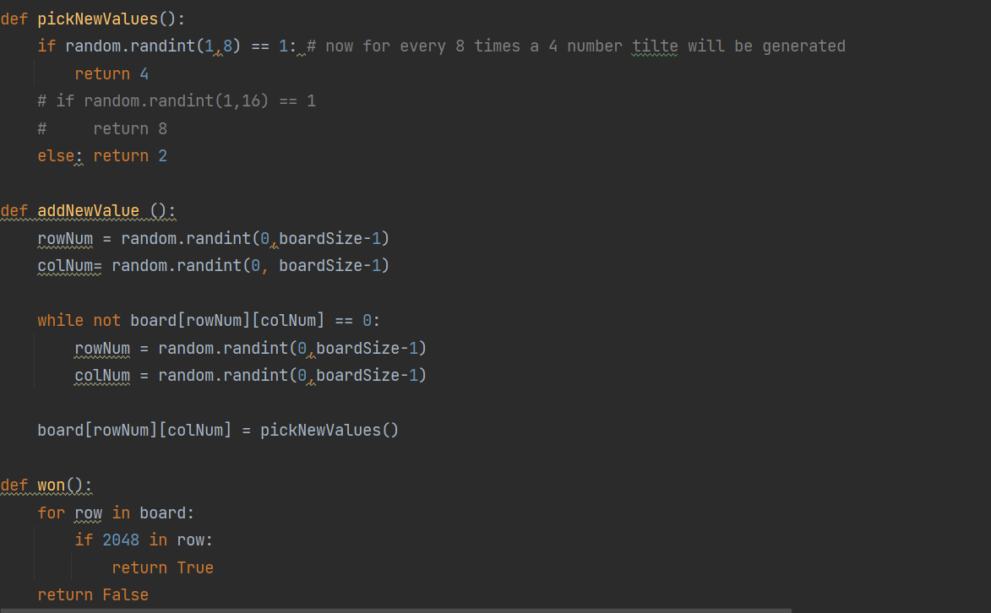

Slide 15
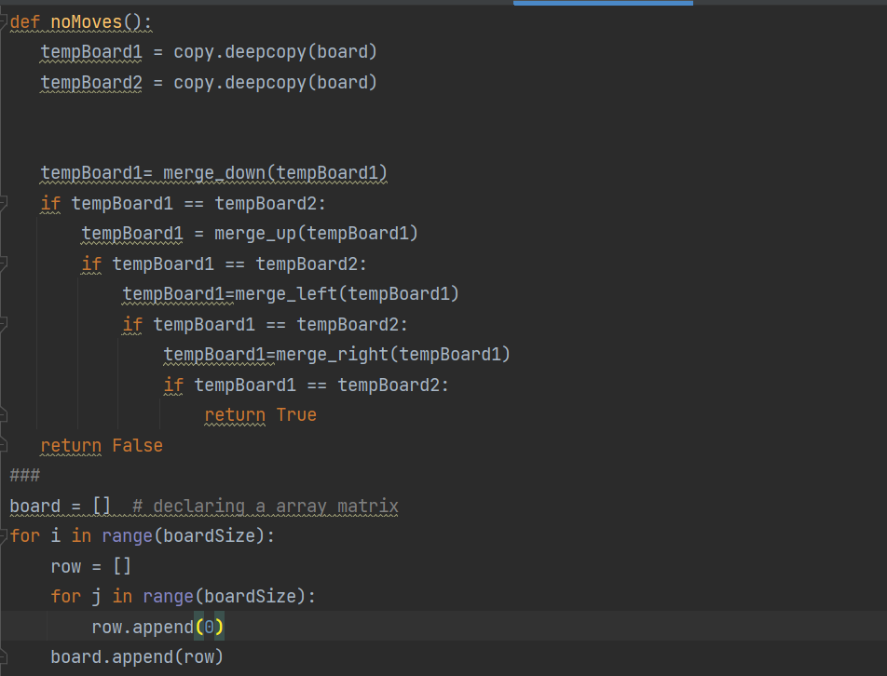

Slide 16
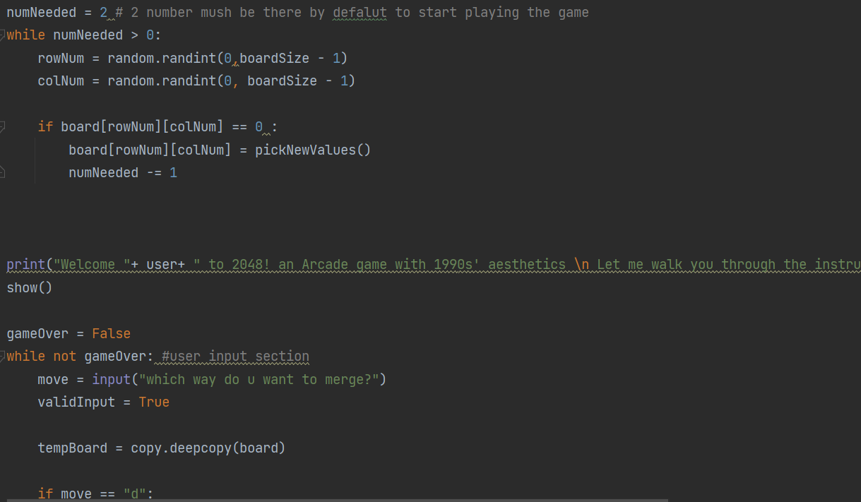

Slide 17
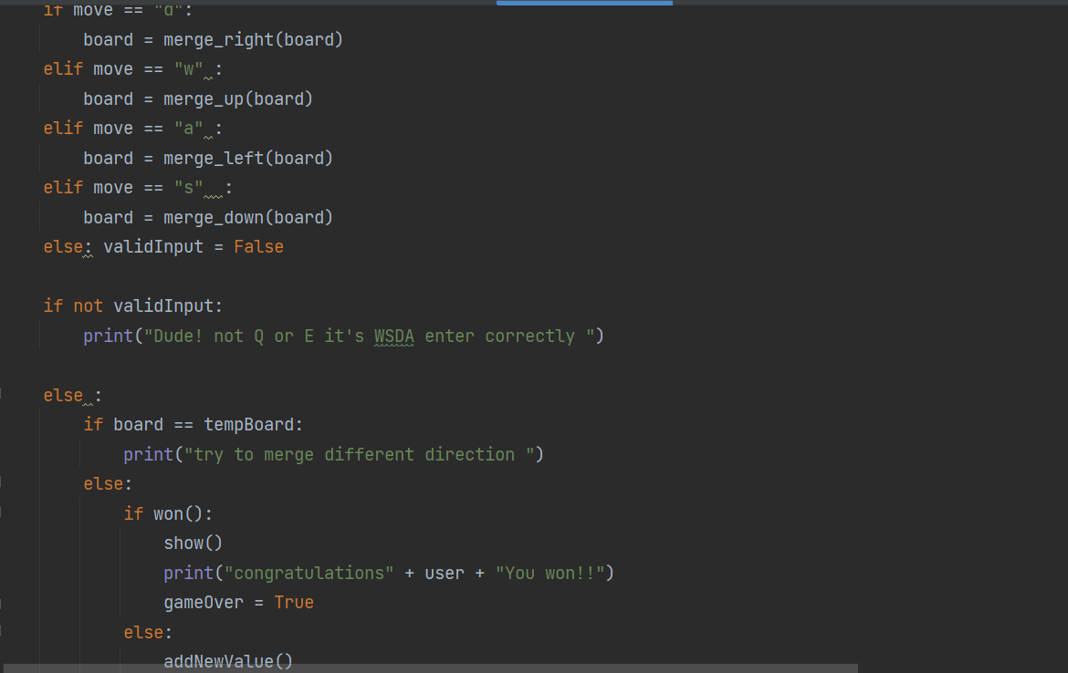

Slide 18
Data-Structure Used

Slide 19
Depth-First Search (DFS)
Depth First Search, is an edge-based technique.
DFS uses Stack to find the shortest path.
DFS is better when target is far from source.
The DFS needs less memory as it only has to keep track of the nodes in a chain from the top to the bottom.
The time complexity of DFS is O(V + E) where V is the number of vertices and E is the number of edges.

Slide 20
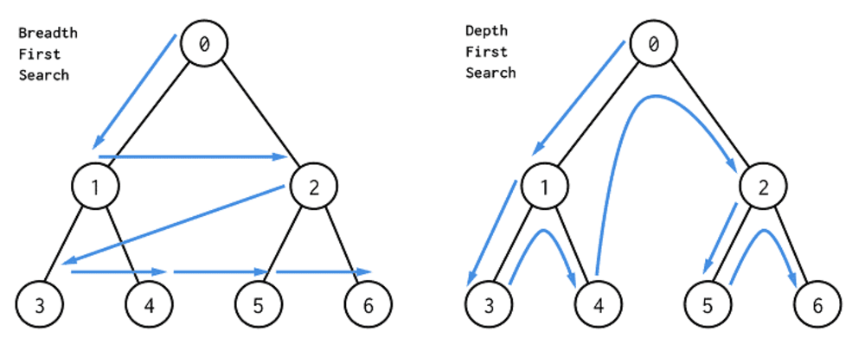

Slide 21
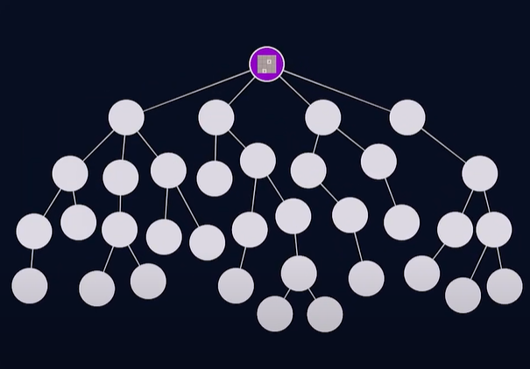
In our case
Root node default case

Slide 22
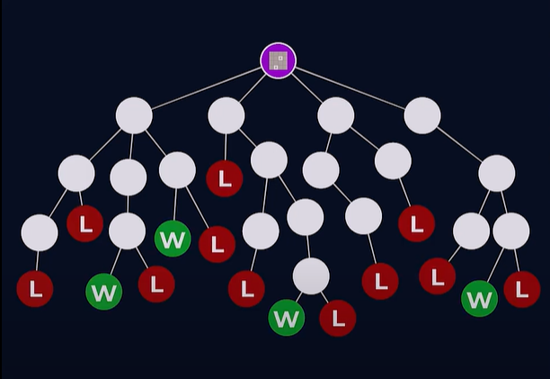
All leaf nodes are possible directions to find win or loose.

Slide 23
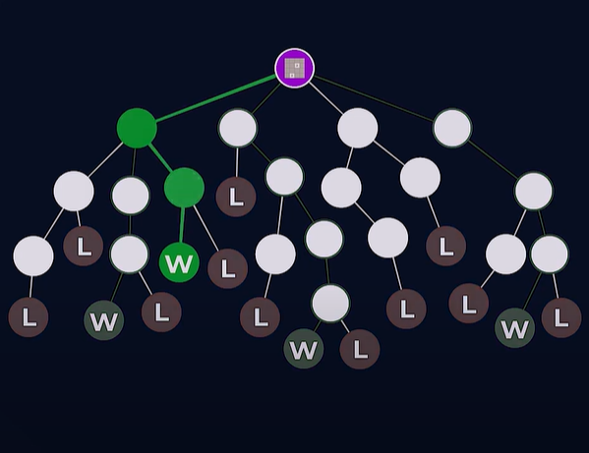
As there are 11 levels to reach 2048 (2^11)
It might take 100s of combinations before reaching the winning node.

Slide 24
Future Work

Slide 25
Is there any optimal way to code ??
AI opens doors for further improvement.
There are n numbers of algorithms to solve this problem like Minmax algorithm or we can use any optimizations like expectimax optimization.

Slide 26
To assess the score performance of the AI, Someone tested it 100 times.
The median score is 387222. The AI never failed to obtain the 2048 tile (so it never lost the game even once in 100 games)
This game took 27830 moves over 96 minutes or an average of 4.8 moves per second.

Slide 27
Limitations

Slide 28
For DFS
Not Guaranteed that it will give you a solution.
Cut-off depth is smaller so time complexity is more.
Determination of depth until the search has proceeded.

Slide 29
For 2048
Since there are only 16 squares on the board, the highest possible value that can appear in a single cell is 217=131072217=131072
The value of each grid cell is a power of two
After making some highest value 2^k , in order to get ahead to a cell with value 2^k+1 you first have to make another copy of 2^k .
Just before you make the second copy of 2^k , you must reach a situation where there is one copy of 2^k and two copies of 2^k−1 .
Continuing this process, we ultimately find that in order to progress to a square of value 2^k+1 , you have to pass through a state where squares of values 22,22,23,24,25,…,2^k all exist simultaneously.
if you are lucky with how the numbers spawn, it is possible to reach that upper bound, so the bound is tight.

Slide 30
Bibliography
https://www.quora.com/Is-it-possible-to-design-an-algorithm-that-can-play-the-puzzle-game-2048-forever
https://www.quora.com/Whats-the-algorithm-behind-the-2048-puzzle
https://towardsdatascience.com/playing-2048-with-minimax-algorithm-1-d214b136bffb
https://stackoverflow.com/questions/22342854/what-is-the-optimal-algorithm-for-the-game-2048
https://projectgurukul.org/python-2048-game/

Slide 31
Thank you
Somesh Rao Coka​
cokasomeshrao@outlook.com
ST122892

